Slide 1
Responsive Design
Akemi Sai and Edward Marecos

Slide 2
What is Responsive Design and Why Use Jetpack Compose?
Responsive design ensures that an app’s layout and UI adapt seamlessly to different screen sizes, resolutions, and orientations. Whether on a phone, tablet, or wearable device, a responsive app provides an optimal user experience by dynamically adjusting content to fit the screen.
Jetpack Compose is a modern toolkit for building Android UIs declaratively. It simplifies responsive design by offering flexible layouts and built-in tools like Modifier, BoxWithConstraints, and ConstraintLayout to easily handle various devices and orientations without complex XML management.

Slide 3
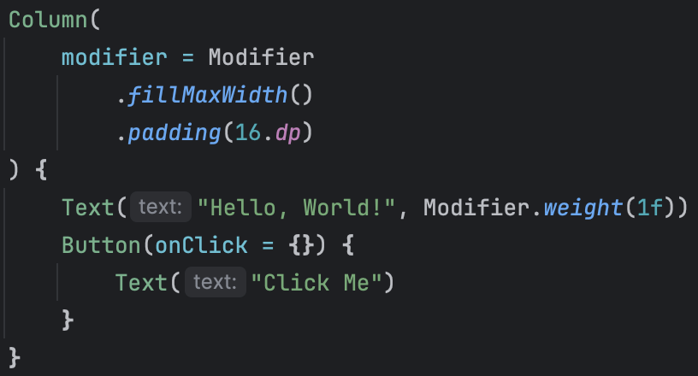
Modifiers for Flexible layouts
fillMaxSize()
makes a component fill the entire available spaces
wrapContentSize()
lets the component take up only as much as space as it needs
weight()
divides available space proportionally between components
padding() and margin()
adjust the spacing around components depending on screen size

Slide 4
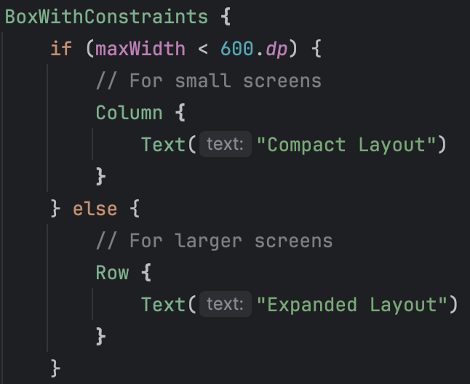
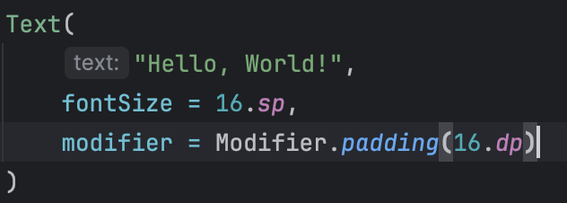
Handling Different Screen Sizes & Resolutions
BoxWithConstraints
allows you to respond to the size of the screen or container and adjust the layout accordingly
dp and sp
dp: independent pixels for layouts
sp: scalable pixels for text
ensure consistent sizing across devices with different resolutions and density.

Slide 5
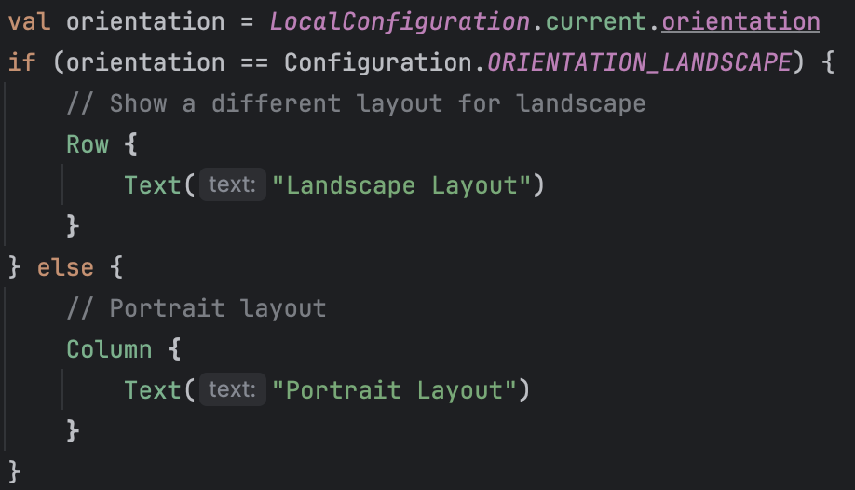
Handling Orientation Changes & Different Devices
LocalConfiguration.current.orientation
Jetpack Compose automatically adapts the UI to orientation changes, but you can manually adjust your layout for different orientations.
LocalConfiguration.current.orientation detects current screen orientation.

Slide 6
Real-World Example: Air bnb

Slide 7
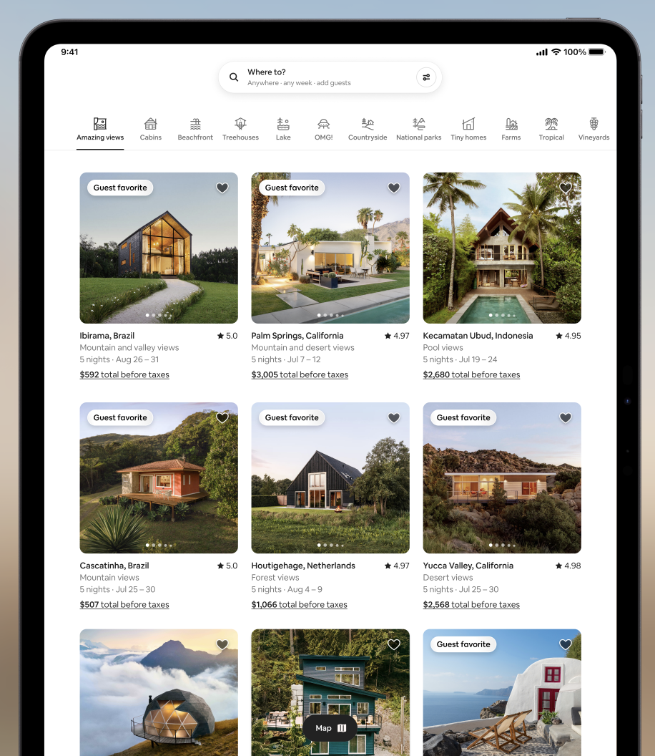
LazyGrid
To handle a large number of listings efficiently, Airbnb likely uses LazyVerticalGrid, which load content dynamically as the user scrolls, optimizing both performance and memory usage.

Slide 8
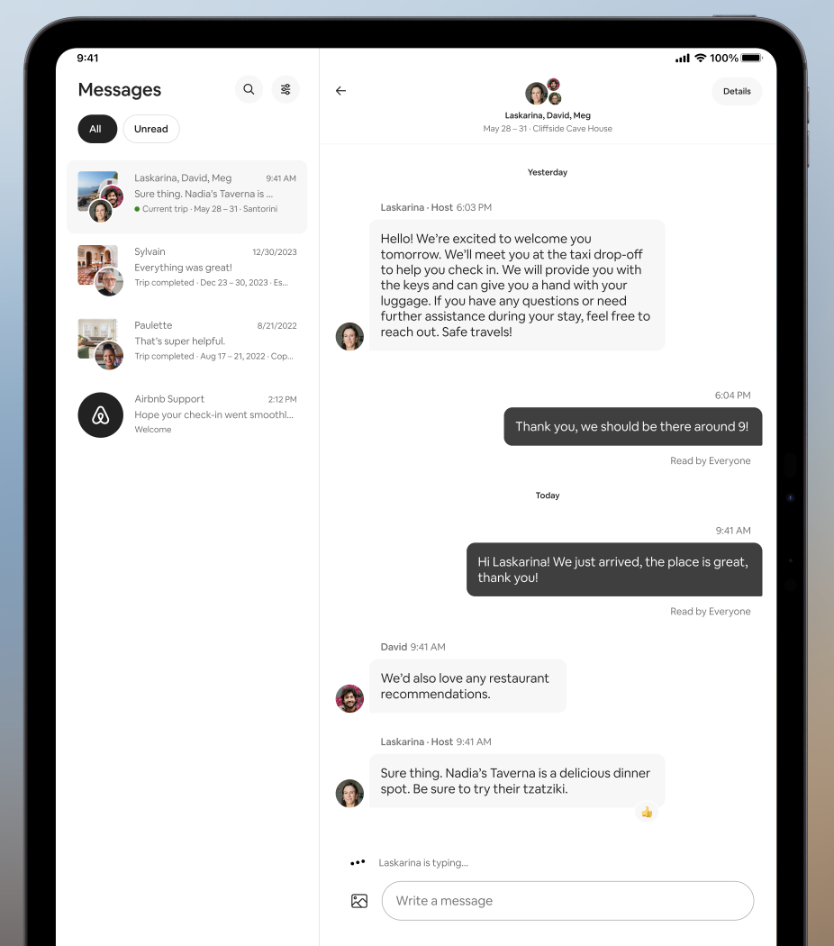
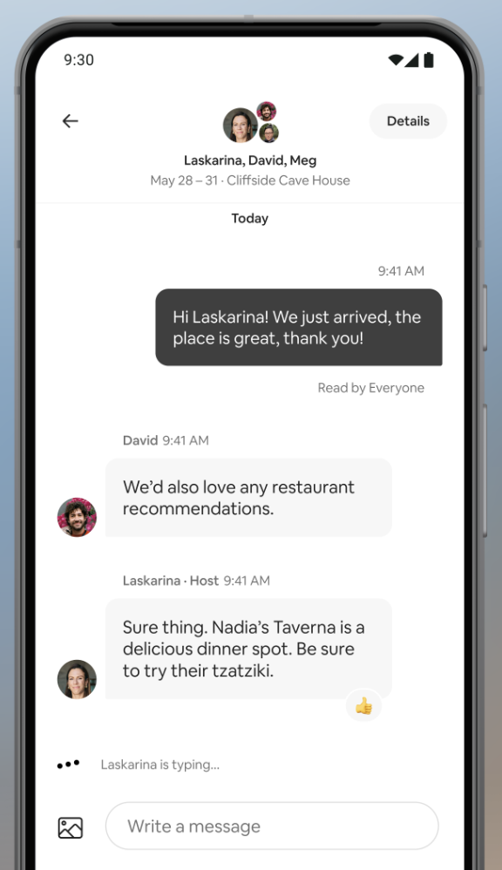
Single and Multi-pane layouts
Airbnb implements single-pane navigation on mobile devices where the app displays only one screen at the time. on larger screen likes tablets, Airbnb uses multi-pane layouts, showing the conversations page on the left, and the messages on the right.

Slide 9
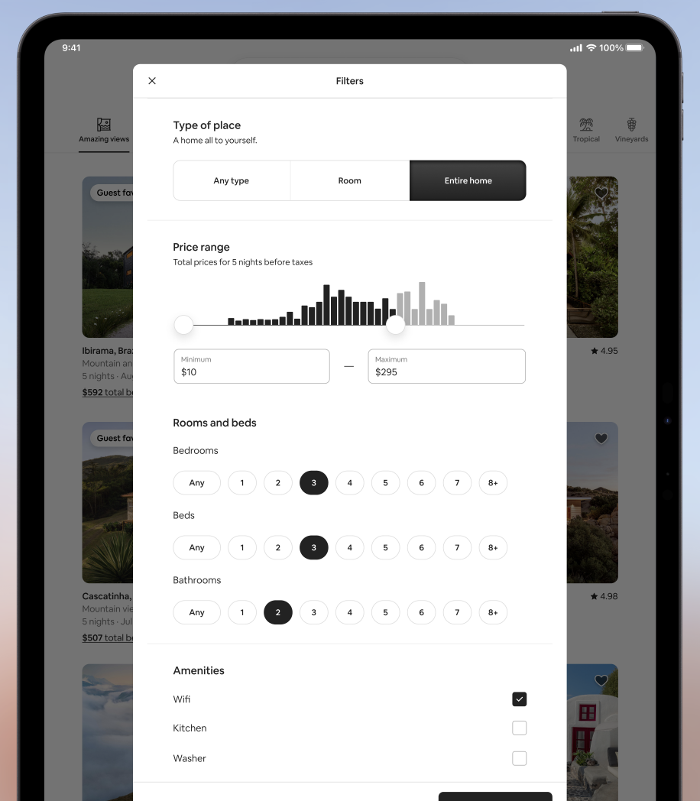
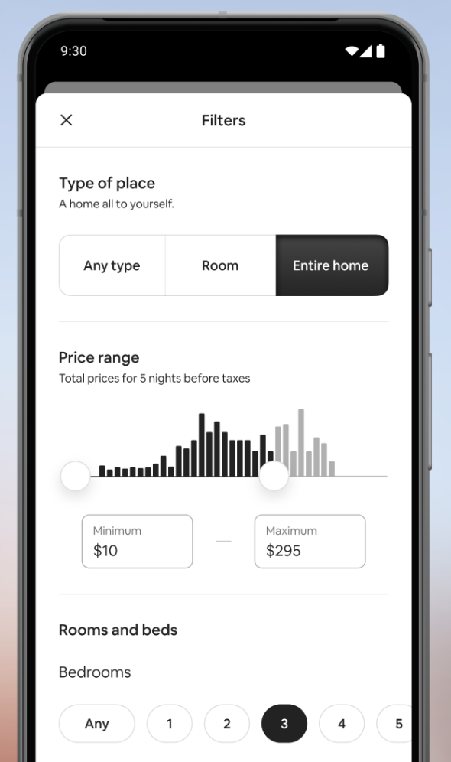
Dynamic Content Adaptation
Typography
Text components such as titles, descriptions, and prices use adaptive font sizes, managed with Compose’s TextStyle. Ensuring the readability on both small phone screens and large tablets, with font scaling applied based on sp units.
Dynamic Image Sizing
With Jetpack Compose’s Modifier and Layout, images and UI components in the filters page, such as buttons and selection icons, adapt responsively. This ensures that elements like icons resize proportionally scores various devices.

Slide 10
Our Mini App Demo: Cookie clicker
This app is a Responsive Cookie Clicker - it leverages the tools that Compose offers to make a user friendly experience accessible across screen sizes and orientations.
It adapts dynamically to different screen sizes and orientations across **phones** and **tablets** in both portrait and landscape modes. The app leverages several features to ensure responsiveness:
-BoxWithConstraints: Determines the available screen size (using `maxWidth` and `maxHeight`), allowing the layout to adjust based on the device.
-Screen Density (`dp` and `sp`): Ensures proper scaling of UI elements and text based on device resolution, using `dp` for layout sizes and `sp` for text sizes.
-Orientation Handling: Uses `LocalConfiguration` to switch between portrait and landscape layouts based on device orientation, providing different layouts for different screen orientations.
These features together create a fluid experience where layouts and components adjust automatically based on the available screen size, ensuring the app looks good on all devices.

Slide 11
Supported Devices
…

